Slide 1
Session 17
APS Eligibility ITS Infinity
Presented by Clinton Naidu & Linda Putu

Slide 2
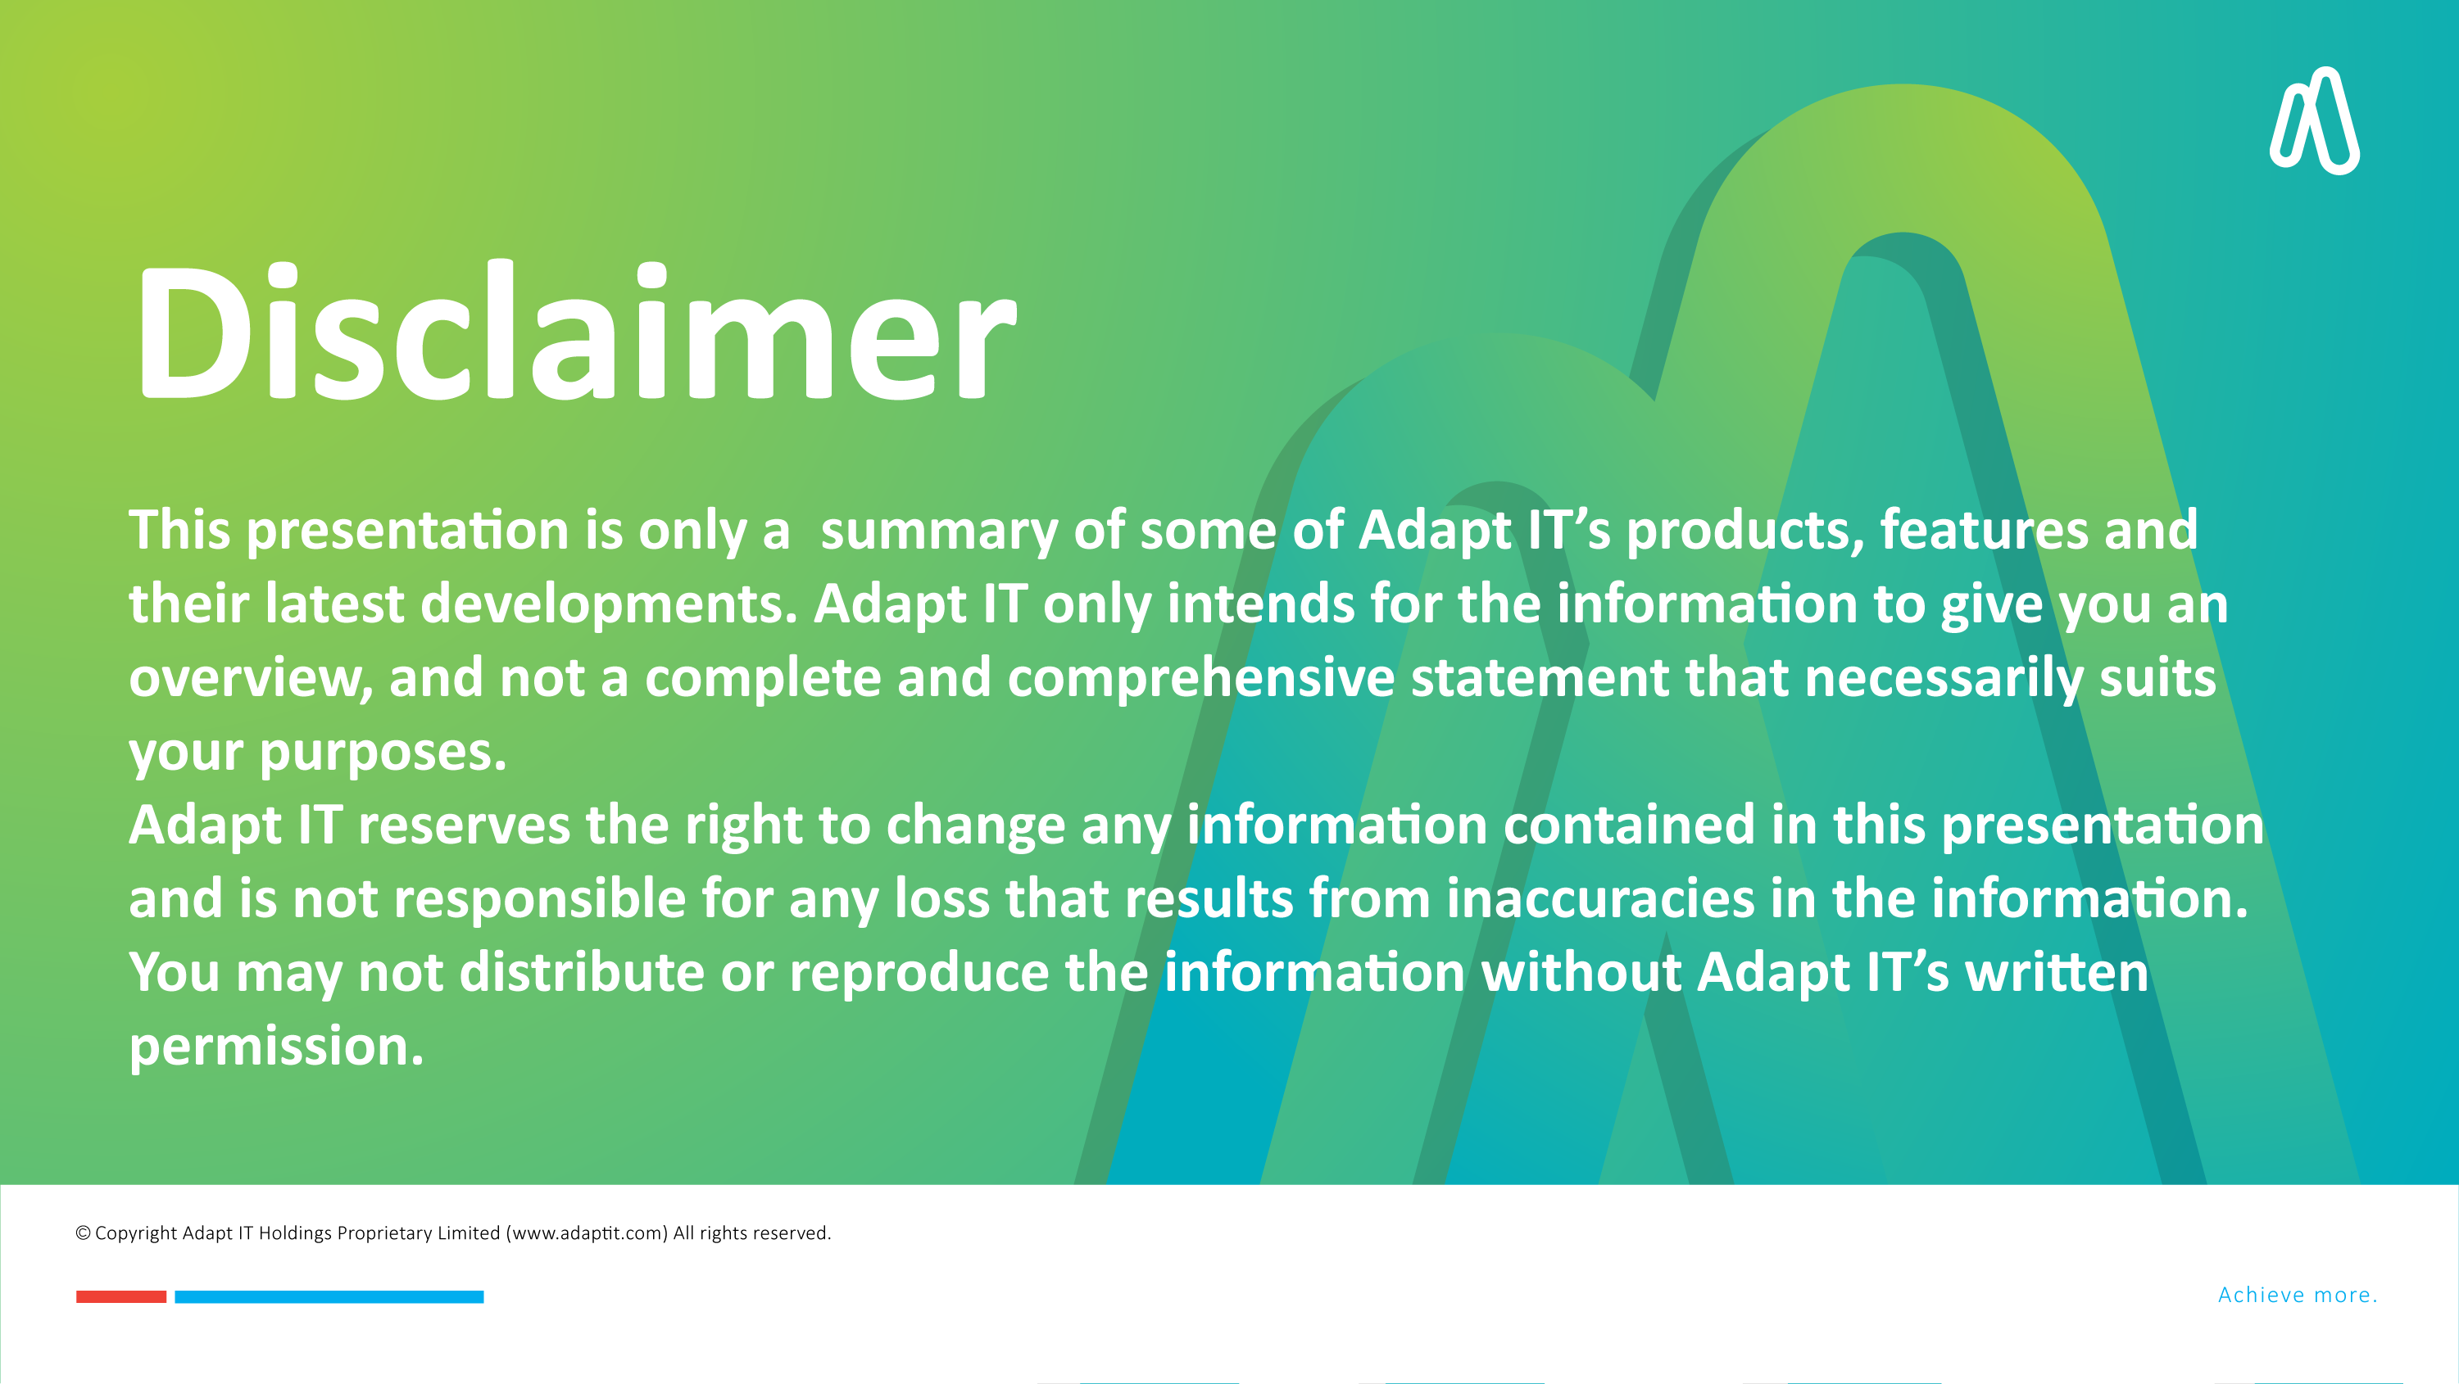

DISCLAIMER
This presentation is only a summary of some of Adapt IT’s products, features and their latest developments. Adapt IT only intends for the information to give you an overview, and not a complete and comprehensive statement that necessarily suits your purposes.
Adapt IT reserves the right to change any information contained in this presentation and is not responsible for any loss that results from inaccuracies in the information. You may not distribute or reproduce the information without Adapt IT’s written permission.

Slide 3

Table of contents
APS & Eligibility Highlights
Features & Functionality
Your thoughts and comments

Slide 4
APS & Eligibility Highlights

Slide 5
APS & Eligibility Highlights
Top-Down Setup
Current Matric
Matric Upgrade
RPL
Multiple Matric Types
Eligibility Blocks
Differing APS Eligibility Scores
Subject Caps
Complex Rules
Maximum Subjects
In-line APS & Eligibility

Slide 6
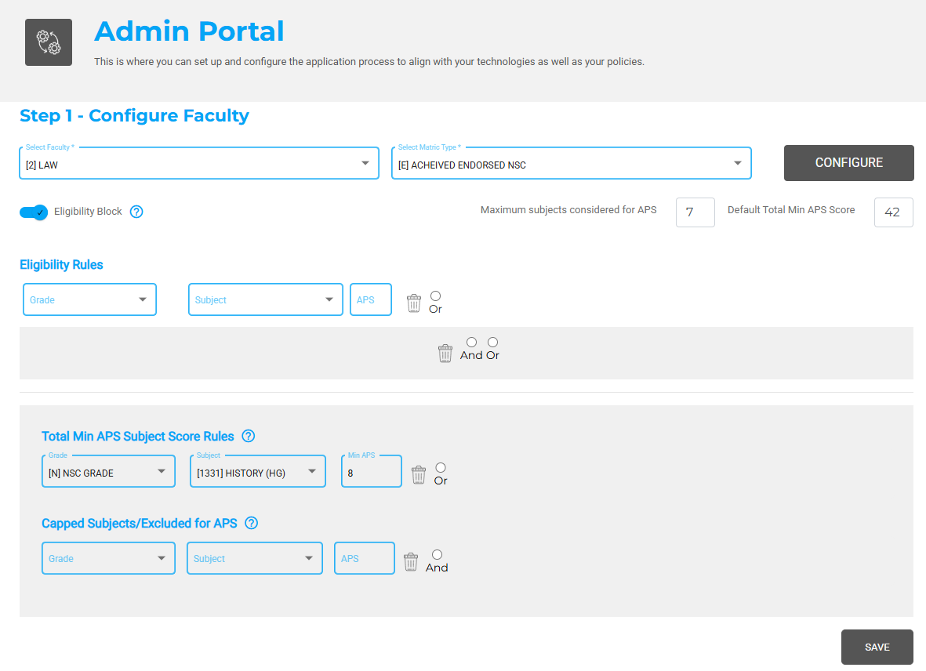
APS & Eligibility Highlights

Slide 7
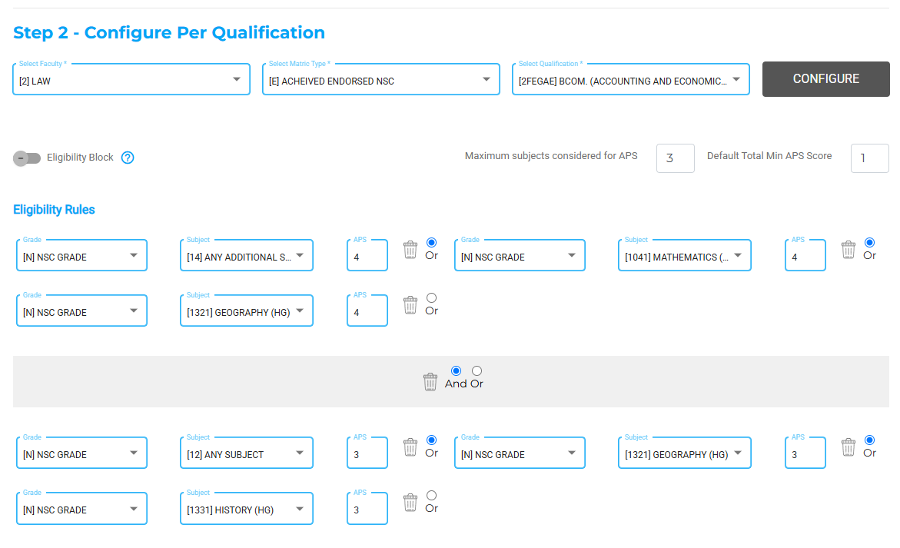
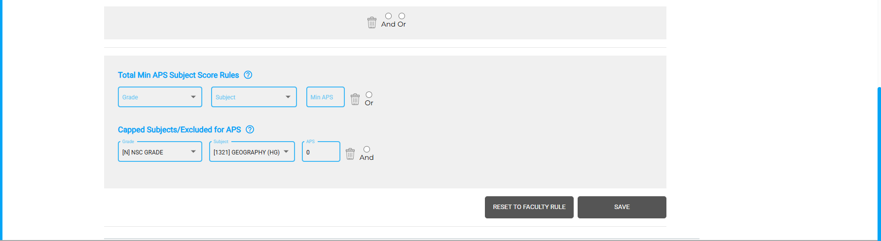
APS & Eligibility Highlights

Slide 8
Features & Functionality

Slide 9
Top-Down Setup
Set a rule at faculty level
Rule pre-fills at Qualification level
Capture Qualification Exceptions

Slide 10
Current Matric, Upgrading, RPL
Looks at matric subject requirements
Ignores total APS
Ignores subject APS

Slide 11
Multiple Matric Types
Pre and post 2008 matriculants
International matriculants

Slide 12
Eligibility Blocks
Block students who have the minimum subject requirements but the incorrect matric type

Slide 13
Differing APS Eligibility Scores
Have different total APS for specific subjects. E.g.
  MATHS – Total APS 30
  MATHLIT – Total APS 33

Slide 14
Subject Caps
Cap certain subject’s APS value. E.g.
  Cap Life Orientation to 5.
  All students who get more than a 5 will get a 5

Slide 15
Complex Rules & Maximum Subjects

Slide 16
In-Line APS & Eligibility
APS & Eligibility in Applications
Only allow students to apply for what they are eligible for.

Slide 17
Your thoughts and comments

Slide 18



